Slide 1
Chapter 15: Temperature, Heat and Expansion

Slide 2
This lecture will help you understand:
Temperature
Heat
Specific Heat Capacity
Thermal Expansion

Slide 3
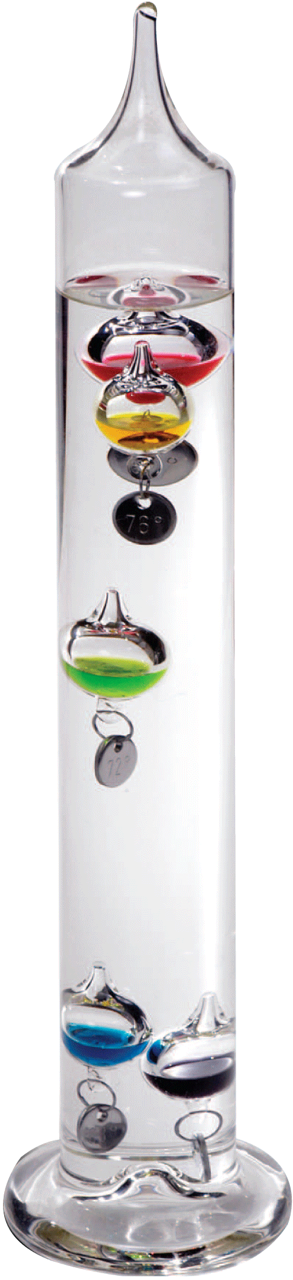
All matter—solid, liquid, and gas—is composed of continually jiggling atoms or molecules. Because of this random motion, the atoms and molecules in matter have kinetic energy. The average kinetic energy of these individual particles causes an effect we can sense—warmth.

Slide 4
Whenever something becomes warmer, the kinetic energy of its atoms or molecules has increased.
When the atoms or molecules in matter move faster, the matter gets warmer. Its atoms or molecules have more kinetic energy.
Temperature:
The higher the temperature of a substance, the faster is the motion of its molecules.

Slide 5
Temperature
The quantity that tells how hot or cold something is compared with a standard is temperature.
Nearly all matter expands when its temperature increases and contracts when its temperature decreases.
A common thermometer measures temperature by showing the expansion and contraction of a liquid in a glass tube using a scale.

Slide 6
True or False? Temperature is a measure of the total kinetic energy in a substance
Temperature
CHECK YOUR NEIGHBOR
Notes:
B. The pressure is 1/3 the original pressure.

Slide 7
True or False? Temperature is a measure of the total kinetic energy in a substance
Temperature
CHECK YOUR NEIGHBOR
Explanation:
Temperature is a measure of the average (not total!) translational kinetic energy of molecules in a substance. For example, there is twice as much total molecular kinetic energy in 2 L of boiling water as in 1 L but the temperature of the two volumes of water are the same because the average translational kinetic energy per molecule is the same in each
Notes:
B. The pressure is 1/3 the original pressure.

Slide 8
Temperature
Celsius Scale
The most widely used temperature scale is the Celsius scale.
  The number 0 is the temperature at which water freezes.
  The number 100 is the temperature at which water boils.
The gap between freezing and boiling is divided into 100 equal parts, called degrees.

Slide 9
Temperature
Fahrenheit Scale
The temperature scale used commonly in the United States is the Fahrenheit scale.
  The number 32 is the temperature at which water freezes.
  The number 212 is the temperature at which water boils.
  The Fahrenheit scale will become obsolete if and when the United States goes metric.

Slide 10
Temperature
Kelvin Scale
Scientific research uses the SI scale—the Kelvin scale.
  Degrees are the same size as the Celsius degree and are called “kelvins.”
  On the Kelvin scale, the number 0 is assigned to the lowest possible temperature—absolute zero.
  At absolute zero a substance has no kinetic energy to give up.
  Zero on the Kelvin scale corresponds to -273°C.

Slide 11
Temperature
Scale Conversion
Arithmetic formulas can be used for converting from one temperature scale to another.
A conversion from Celsius to Fahrenheit, or vice versa, can be very closely approximated by simply reading the corresponding temperature from side-by-side scales.

Slide 12
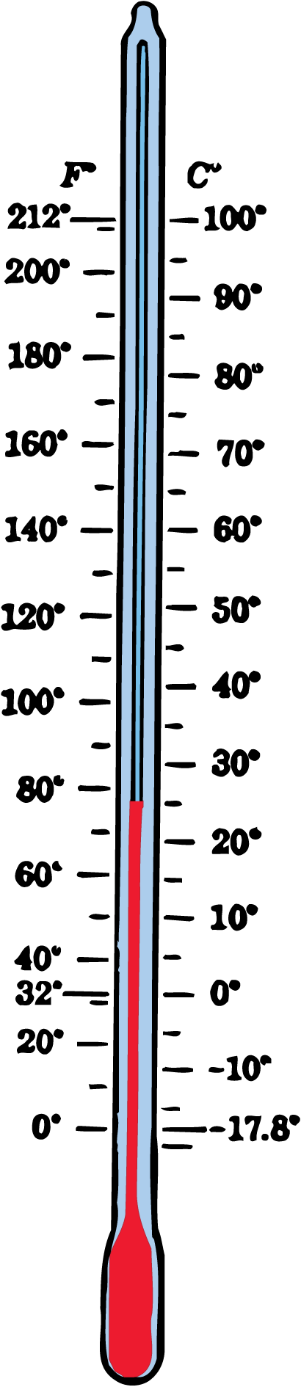
Temperature
This thermometer measures temperature on both Fahrenheit and Celsius scales.

Slide 13
Temperature
Temperature and Kinetic Energy
Temperature is related to the random motions of the molecules in a substance.
In the simplest case of an ideal gas, temperature is proportional to the average kinetic energy of molecular translational motion.

Slide 14
Temperature
In solids and liquids, where molecules are more constrained and have potential energy, temperature is more complicated.
The warmth you feel when you touch a hot surface is the kinetic energy transferred by molecules in the surface to molecules in your fingers.

Slide 15
Temperature
Temperature is not a measure of the total kinetic energy of all the molecules in a substance.
Two liters of boiling water have twice as much kinetic energy as one liter.
The temperatures are the same because the average kinetic energy of molecules in each is the same.

Slide 16
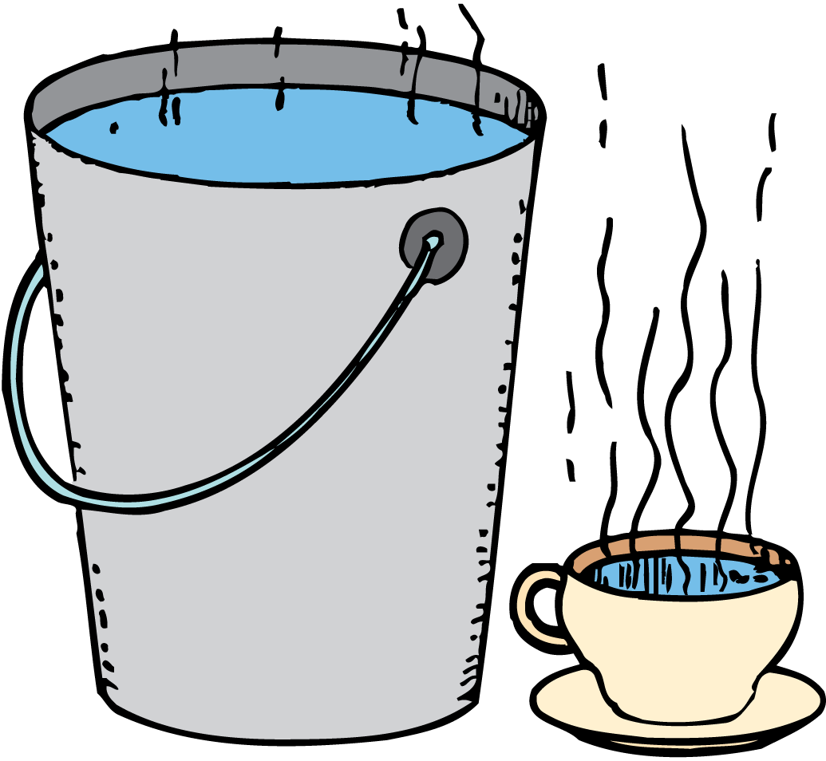
Temperature
There is more molecular kinetic energy in the bucketful of warm water than in the small cupful of higher-temperature water.

Slide 17

Temperature
What is the relationship between the temperature of a substance and the speed of its molecules?

Slide 18

Heat
When two substances of different temperatures are in thermal contact, heat flows from the higher-temperature substance into the lower-temperature substance.

Slide 19
Heat
If you touch a hot stove, energy enters your hand from the stove because the stove is warmer than your hand.
If you touch ice, energy passes from your hand into the colder ice.
The direction of spontaneous energy transfer is always from a warmer to a cooler substance.
The energy that transfers from one object to another because of a temperature difference between them is called heat.

Slide 20
Heat
It is common—but incorrect with physics types—to think that matter contains heat.
Matter contains energy but it does not contain heat.
Heat is energy in transit, moving from a body of higher temperature to one of lower temperature.

Slide 21
Heat
Once transferred, the energy ceases to be heat.
Previously, we call the energy resulting from heat flow thermal energy, to make clear its link to heat and temperature.
We will use the term that scientists prefer, internal energy.
When heat flows from one object or substance to another it is in contact with, the objects are said to be in thermal contact.

Slide 22
Heat
Heat will not necessarily flow from a substance with more total molecular kinetic energy to a substance with less.
  There is more total molecular kinetic energy in a large bowl of warm water than there is in a red-hot thumbtack.
  If the tack is immersed in the water, heat flows from the hot tack to the cooler water.
  Heat flows according to temperature differences—that is, average molecular kinetic energy differences.
  Heat never flows on its own from a cooler substance into a hotter substance.

Slide 23
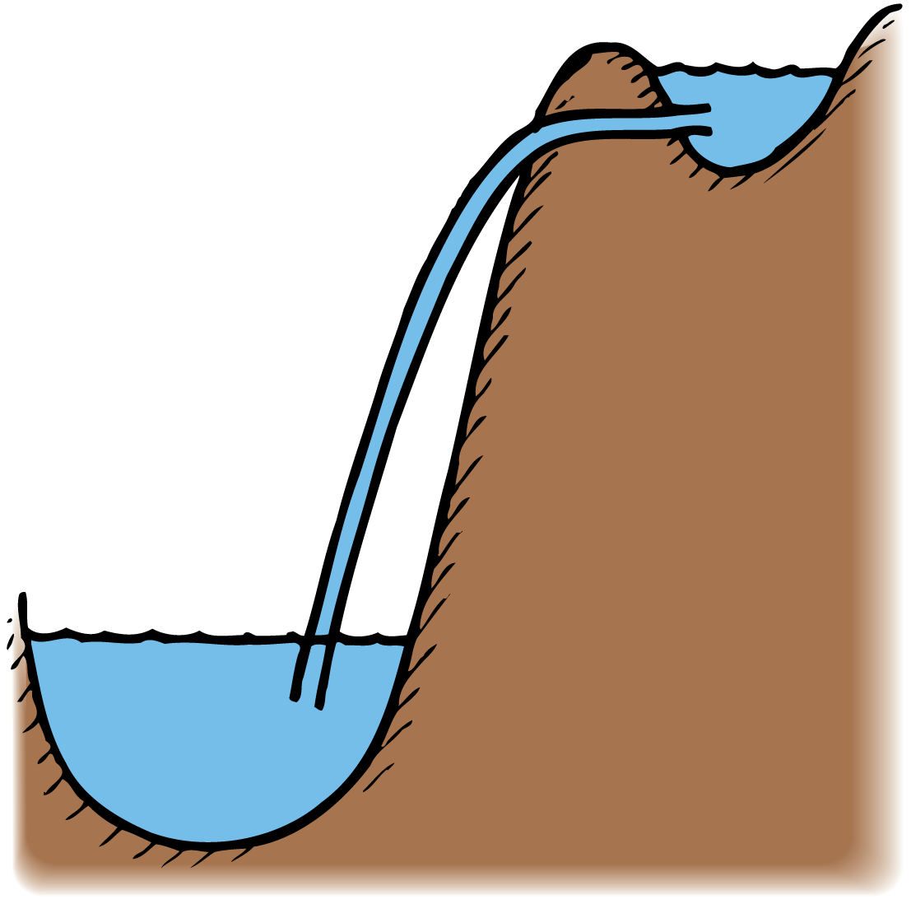
Heat
Just as water will not flow uphill by itself, regardless of the relative amounts of water in the reservoirs, heat will not flow from a cooler substance into a hotter substance by itself.

Slide 24
Heat
What causes heat to flow?

Slide 25
Thermal Equilibrium
When a thermometer is in contact with a substance, heat flows between them until they have the same temperature.

Slide 26
Thermal Equilibrium
After objects in thermal contact with each other reach the same temperature, we say the objects are in thermal equilibrium.
When objects are in thermal equilibrium, no heat flows between them.

Slide 27
Thermal Equilibrium
To read a thermometer we wait until it reaches thermal equilibrium with the substance being measured.
The temperature of the thermometer is also the temperature of the substance.
A thermometer should be small enough that it does not appreciably alter the temperature of the substance being measured.

Slide 28
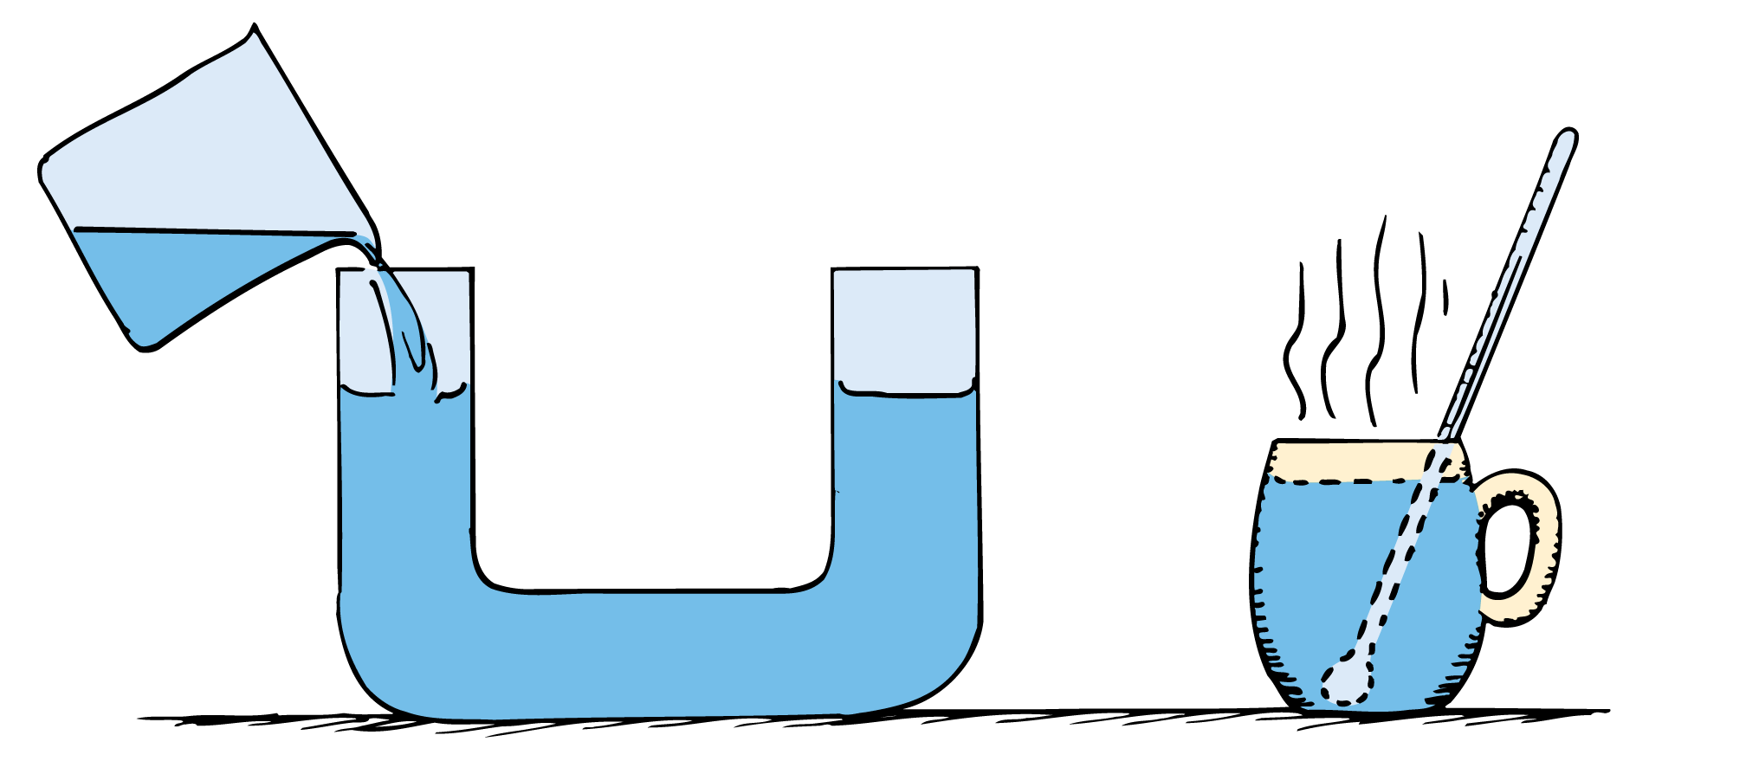
Thermal Equilibrium
Water seeks a common level with pressures at equal elevations the same. The thermometer and its surroundings reach a common temperature with the average kinetic energy per particle the same.

Slide 29
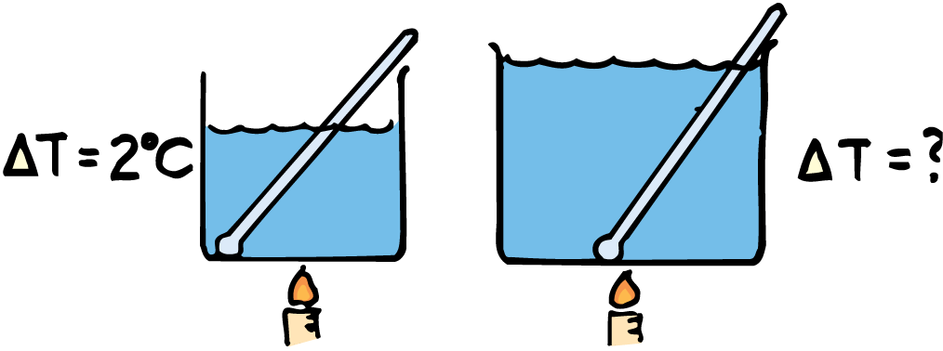
Thermal Equilibrium
think!
Suppose you use a flame to add heat to 1 liter of water, and the water temperature rises by 2°C. If you add the same quantity of heat to 2 liters of water, by how much will its temperature rise?

Slide 30
Thermal Equilibrium
think!
Suppose you use a flame to add heat to 1 liter of water, and the water temperature rises by 2°C. If you add the same quantity of heat to 2 liters of water, by how much will its temperature rise?
Answer:
Its temperature will rise by 1°C, because there are twice as many molecules in 2 liters of water and each molecule receives only half as much energy on average.

Slide 31
Internal Energy
When a substance takes in or gives off heat, its internal energy changes.

Slide 32
Internal Energy
In addition to the translational kinetic energy of jostling molecules in a substance, there is energy in other forms.
  There is rotational kinetic energy of molecules.
  There is kinetic energy due to internal movements of atoms within molecules.
  There is potential energy due to the forces between molecules.
  The total of all energies inside a substance is called internal energy. A substance contains internal energy, not heat.

Slide 33
Internal Energy
Absorbed heat may make the molecules of a substance jostle faster.
In some cases, as when ice is melting, a substance absorbs heat without an increase in temperature.
The substance then changes phase.

Slide 34
Internal Energy
What happens to the internal energy of a substance that takes in or gives off heat?

Slide 35
Measurement of Heat
The amount of heat transferred can be determined by measuring the temperature change of a known mass of a substance that absorbs the heat.

Slide 36
Measurement of Heat
Heat is energy transferred from one substance to another by a temperature difference.
When a substance absorbs heat, the resulting temperature change depends on more than just the mass of the substance.
To quantify heat, we must specify the mass and kind of substance affected.

Slide 37
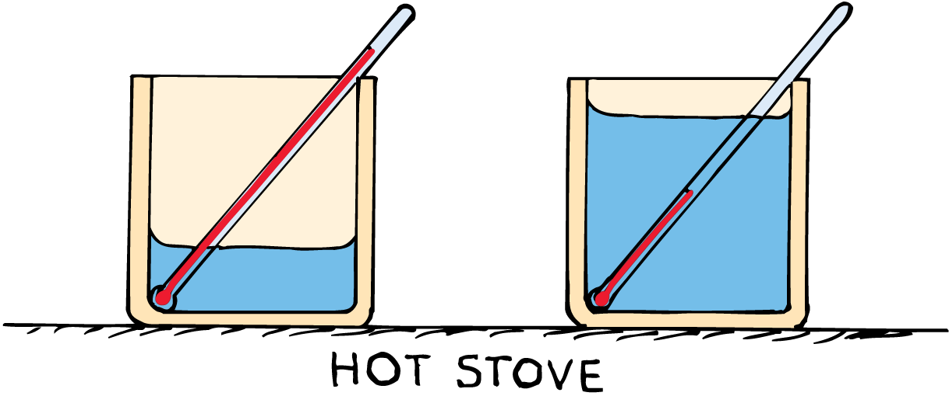
Measurement of Heat
Although the same quantity of heat is added to both containers, the temperature of the container with less water increases more.

Slide 38
Measurement of Heat
The unit of heat is defined as the heat necessary to produce a standard temperature change for a specified mass of material.
The most commonly used unit for heat is the calorie.
The calorie is defined as the amount of heat required to raise the temperature of 1 gram of water by 1°C.

Slide 39
Measurement of Heat
The kilocalorie is 1000 calories (the heat required to raise the temperature of 1 kilogram of water by 1°C).
The heat unit used in rating foods is actually a kilocalorie, although it’s often referred to as the calorie.
To distinguish it from the smaller calorie, the food unit is sometimes called a Calorie (written with a capital C).

Slide 40
Measurement of Heat
The calorie and the Calorie are units of energy.
In the International System of Units (SI), quantity of heat is measured in joules, the SI unit for all forms of energy.
One calorie equals 4.186 J.

Slide 41
Measurement of Heat
The energy value in food is determined by burning the food and measuring the energy that is released as heat.
Food and other fuels are rated by how much energy a certain mass of the fuel gives off as heat when burned.

Slide 42
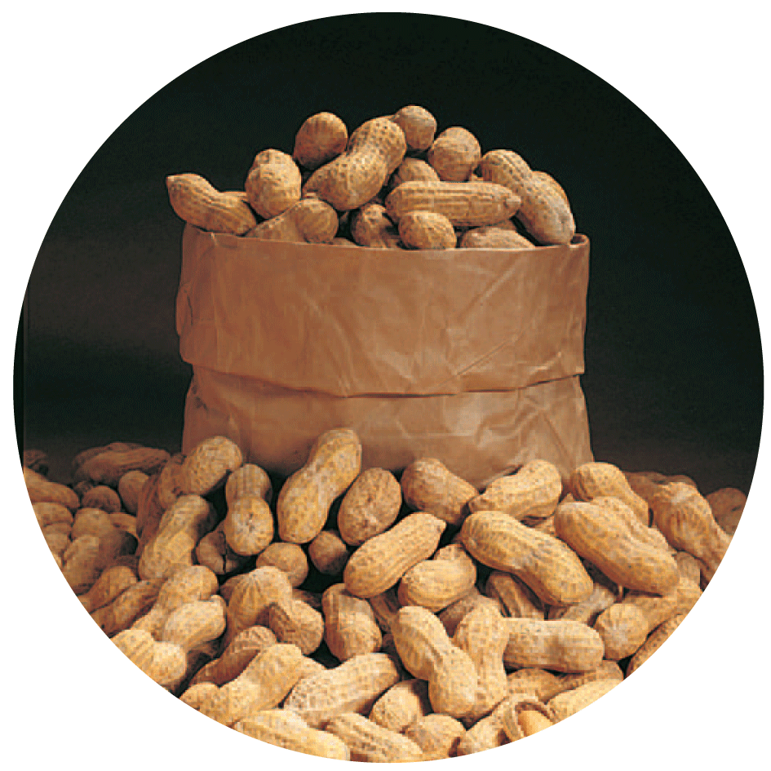
Measurement of Heat
To the weight watcher, the peanut contains 10 Calories; to the physicist, it releases 10,000 calories (or 41,860 joules) of energy when burned or digested.

Slide 43
Measurement of Heat
think!
Which will raise the temperature more, adding 1 calorie or 4.186 joules?

Slide 44
Measurement of Heat
think!
Which will raise the temperature more, adding 1 calorie or 4.186 joules?
Answer:
Both are the same. This is like asking which is longer,
a 1-mile-long track or a 1.6-kilometer-long track. They’re
the same quantity expressed in different units.

Slide 45
Specific Heat Capacity
The capacity of a substance to store heat depends on its chemical composition.

Slide 46
Specific Heat Capacity
Some foods remain hot much longer than others.
  Boiled onions, for example, are often too hot to eat while mashed potatoes may be just right.
  The filling of hot apple pie can burn your tongue while the crust will not when the pie has just been taken out of the oven.
  An aluminum foil covering can be peeled off with bare fingers right out of the oven, but be careful of the food beneath it.

Slide 47
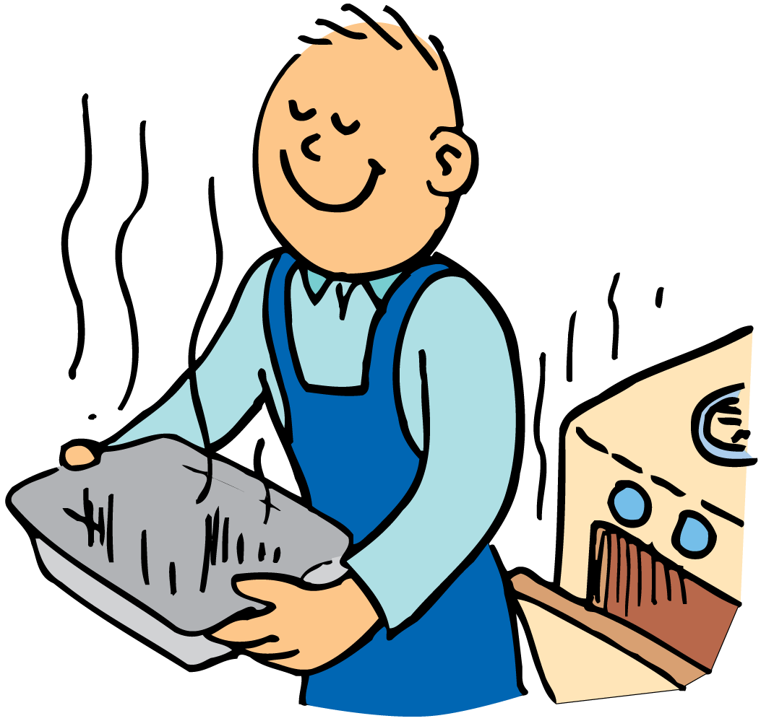
Specific Heat Capacity
You can touch the aluminum pan of the frozen dinner soon after it has been taken from the hot oven, but you’ll burn your fingers if you touch the food it contains.

Slide 48
Specific Heat Capacity
Different substances have different capacities for storing internal energy, or heat.
  A pot of water on a stove might require 15 minutes to be heated from room temperature to its boiling temperature.
  An equal mass of iron on the same flame would rise through the same temperature range in only about 2 minutes.
  For silver, the time would be less than a minute.

Slide 49
Specific Heat Capacity
A material requires a specific amount of heat to raise the temperature of a given mass a specified number of degrees.
The specific heat capacity of a material is the quantity of heat required to raise the temperature of 1 gram by 1 degree.

Slide 50
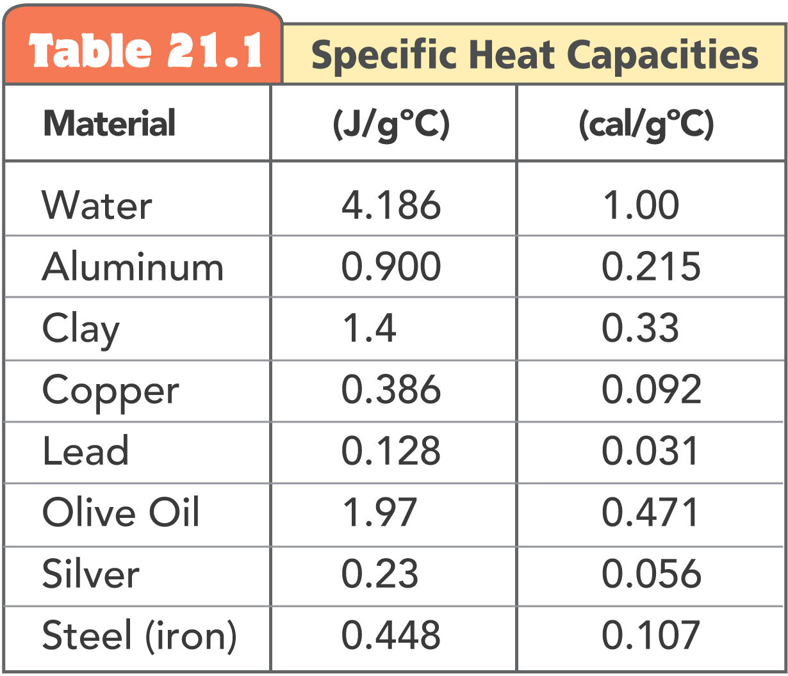
Specific Heat Capacity

Slide 51
Specific Heat Capacity
Recall that inertia is a term used in mechanics to signify the resistance of an object to change in its state of motion.
Specific heat capacity is like a thermal inertia since it signifies the resistance of a substance to change in its temperature.

Slide 52
Specific Heat Capacity
A gram of water requires 1 calorie of energy to raise the temperature 1°C.
It takes only about one eighth as much energy to raise the temperature of a gram of iron by the same amount.

Slide 53
Specific Heat Capacity
Absorbed energy can affect substances in different ways.
  Absorbed energy that increases the translational speed of molecules is responsible for increases in temperature.
  Temperature is a measure only of the kinetic energy of translational motion.
  Absorbed energy may also increase the rotation of molecules, increase the internal vibrations within molecules, or stretch intermolecular bonds and be stored as potential energy.

Slide 54
Specific Heat Capacity
Iron atoms in the iron lattice primarily shake back and forth, while water molecules soak up a lot of energy in rotations, internal vibrations, and bond stretching.
Water absorbs more heat per gram than iron for the same change in temperature.
Water has a higher specific heat capacity (sometimes simply called specific heat) than iron has.

Slide 55
Specific Heat Capacity
think!
Which has a higher specific heat capacity—water or sand? Explain.

Slide 56
Specific Heat Capacity
think!
Which has a higher specific heat capacity—water or sand? Explain.
Answer:
Water has a greater heat capacity than sand. Water is much slower to warm in the hot sun and slower to cool at night. Sand’s low heat capacity, shown by how quickly it warms in the morning and how quickly it cools at night, affects local climates.

Slide 57
Specific Heat Capacity
Why do different substances have different capacities to store heat?

Slide 58
The High Specific Heat Capacity of Water
The property of water to resist changes in temperature improves the climate in many places.

Slide 59
The High Specific Heat Capacity of Water
Water has a much higher capacity for storing energy than most common materials.
A relatively small amount of water absorbs a great deal of heat for a correspondingly small temperature rise.

Slide 60
The High Specific Heat Capacity of Water
Because of this, water is a very useful cooling agent, and is used in cooling systems in automobiles and other engines.
For a liquid of lower specific heat capacity, temperature would rise higher for a comparable absorption of heat.
Water also takes longer to cool.

Slide 61
The High Specific Heat Capacity of Water
Water’s capacity to store heat affects the global climate.
Water takes more energy to heat up than land does.
Europe and the west coast of the United States both benefit from this property of water.

Slide 62
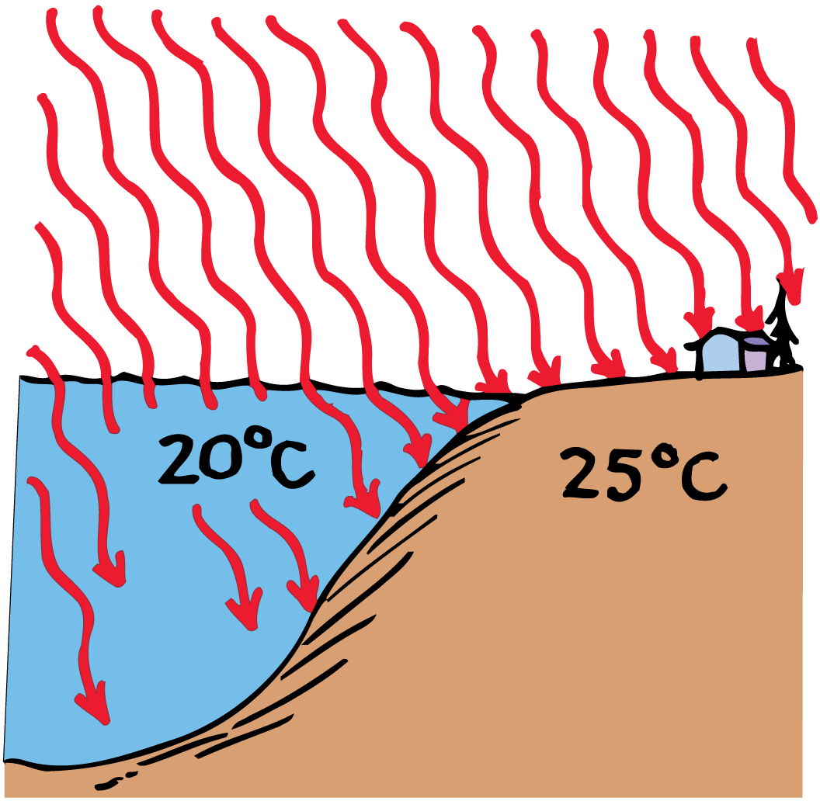
The High Specific Heat Capacity of Water
Water has a high specific heat and is transparent, so it takes more energy to heat up than land does.

Slide 63
The High Specific Heat Capacity of Water
Climate of Europe
Look at a world globe and notice the high latitude of Europe.
Both Europe and Canada get about the same amount of the sun’s energy per square kilometer.

Slide 64
The High Specific Heat Capacity of Water
The Atlantic current known as the Gulf Stream brings warm water northeast from the Caribbean.
It holds much of its internal energy long enough to reach the North Atlantic off the coast of Europe.
As it cools, the energy released is carried by the prevailing westerly winds over the European continent.

Slide 65
The High Specific Heat Capacity of Water
Climate of America
Climates differ on the east and west coasts of North America. The prevailing winds in the latitudes of North America are westerly.
On the west coast, air moves from the Pacific Ocean to the land.
  In winter, the water warms the air that moves over it and warms the western coastal regions of North America.
  In summer, the water cools the air and the western coastal regions are cooled.

Slide 66
The High Specific Heat Capacity of Water
On the east coast, air moves from the land to the Atlantic Ocean.
  Land, with a lower specific heat capacity, gets hot in summer but cools rapidly in winter.
  San Francisco is warmer in the winter and cooler in the summer than Washington, D.C., at about the same latitude.
The central interior of a large continent usually experiences extremes of temperature.

Slide 67
Thermal Expansion
Most forms of matter—solids, liquids, and gases—expand when they are heated and contract when they are cooled.

Slide 68
Thermal Expansion
When the temperature of a substance is increased, its molecules jiggle faster and normally tend to move farther apart.
This results in an expansion of the substance.
  Gases generally expand or contract much more than liquids.
  Liquids generally expand or contract more than solids.

Slide 69
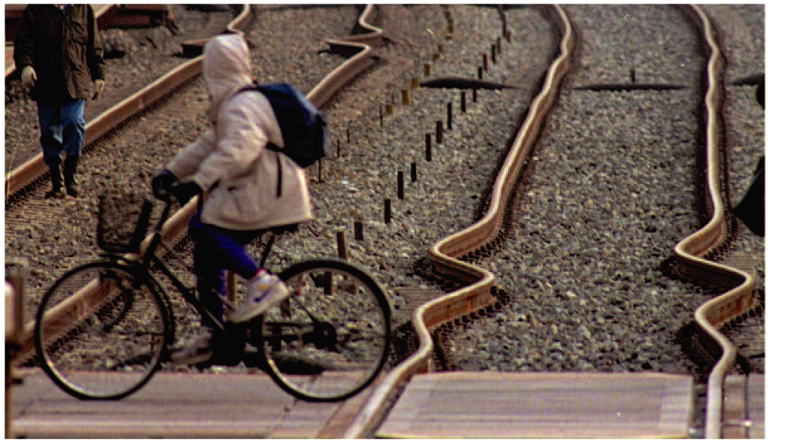
Thermal Expansion
The extreme heat of a July day in Asbury Park, New Jersey, caused the buckling of these railroad tracks.

Slide 70
Thermal Expansion
Expansion Joints
If sidewalks and paving were laid down in one continuous piece, cracks would appear due to expansion and contraction.
To prevent this, the surface is laid in small sections, separated by a small gap that is filled in with a substance such as tar.
On a hot summer day, expansion often squeezes this material out of the joints.

Slide 71
Thermal Expansion
Different materials expand at different rates.
  Dentists use material with the same expansion rate as teeth.
  Aluminum pistons of an automobile engine are smaller in diameter than the steel cylinders to allow for the much greater expansion rate of aluminum.
  Steel with the same expansion rate as concrete reinforces the concrete.
  Long steel bridges often have one end fixed while the other rests on rockers that allow for expansion.

Slide 72
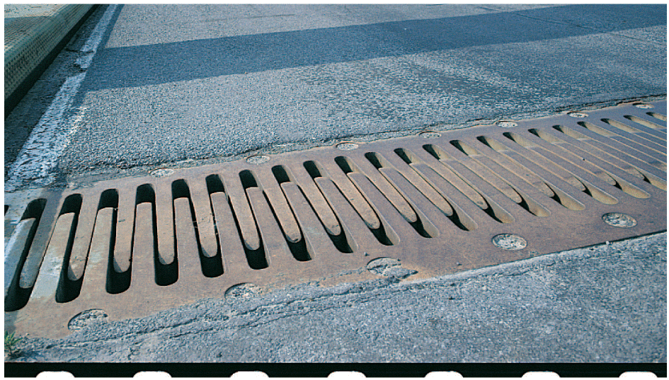
Thermal Expansion
This gap is called an expansion joint, and it allows the bridge to expand and contract.

Slide 73
Thermal Expansion
Bimetallic Strips
In a bimetallic strip, two strips of different metals are welded or riveted together.
  When the strip is heated, one side of the double strip becomes longer than the other, causing the strip to bend into a curve.
  When the strip is cooled, it bends in the opposite direction—the metal that expands the most also contracts the most.
  The movement of the strip can turn a pointer, regulate a valve, or operate a switch.

Slide 74
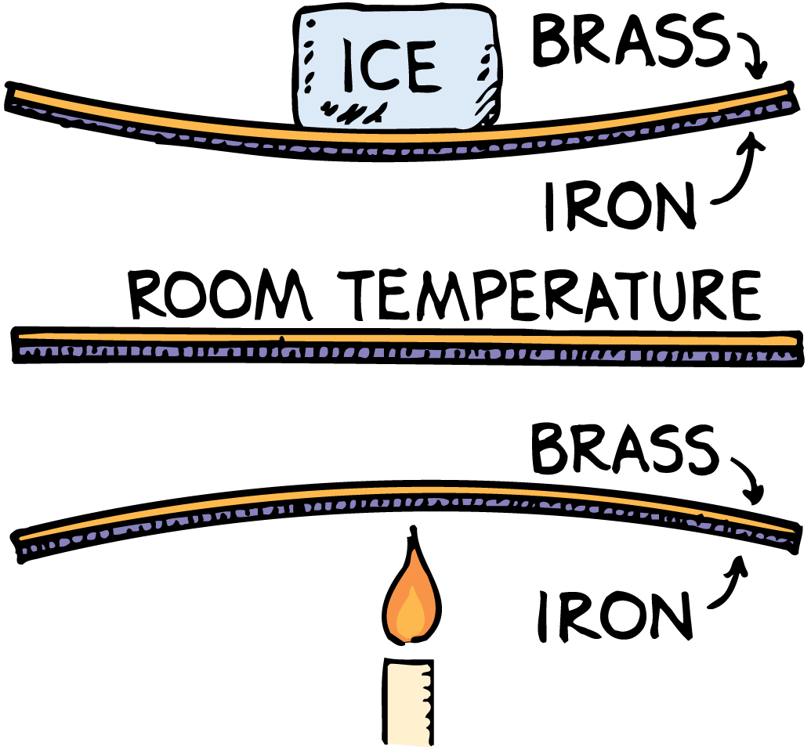
Thermal Expansion
In a bimetallic strip, brass expands (or contracts) more when heated (or cooled) than does iron, so the strip bends as shown.

Slide 75
Thermal Expansion
Thermostats
A thermostat is used to control temperature.
  As the temperature changes, the back-and-forth bending of the bimetallic coil opens and closes an electric circuit.
  When the room is too cold, the coil bends toward the brass side and closes an electric switch that turns on the heat.
  When the room is too warm, the coil bends toward the iron side and opens the switch and turns off the heating unit.
Bimetallic strips are used in refrigerators, oven thermometers, electric toasters, and other devices.

Slide 76

Thermal Expansion
When the bimetallic coil expands, the mercury rolls away from the electrical contacts, breaking the circuit. When the coil contracts, the mercury rolls against the contacts, completing the circuit.

Slide 77
Thermal Expansion
Glass
If one part of a piece of glass is heated or cooled more rapidly than adjacent parts, the expansion or contraction may break the glass.
This is especially true for thick glass.
Borosilicate glass expands very little with increasing temperature.

Slide 78
Thermal Expansion
think!
Why is it advisable to allow telephone lines to sag when stringing them between poles in summer?

Slide 79
Thermal Expansion
think!
Why is it advisable to allow telephone lines to sag when stringing them between poles in summer?
Answer:
Telephone lines are longer in summer, when they are warmer, and shorter in winter, when they are cooler. They therefore sag more on hot summer days than in winter. If the telephone lines are not strung with enough sag in summer, they might contract too much and snap during the winter.

Slide 80
Thermal Expansion
How does matter change when heated or cooled?

Slide 81
Expansion of Water
At 0°C, ice is less dense than water, and so ice floats on water.

Slide 82
Expansion of Water
Almost all liquids will expand when they are heated. Ice-cold water, however, does just the opposite!
  Water at the temperature of melting ice—0°C (or 32°F) —contracts when the temperature is increased.
  As the water is heated and its temperature rises, it continues to contract until it reaches a temperature of 4°C.
  With further increase in temperature, the water then begins to expand.
  The expansion continues all the way to the boiling point.

Slide 83
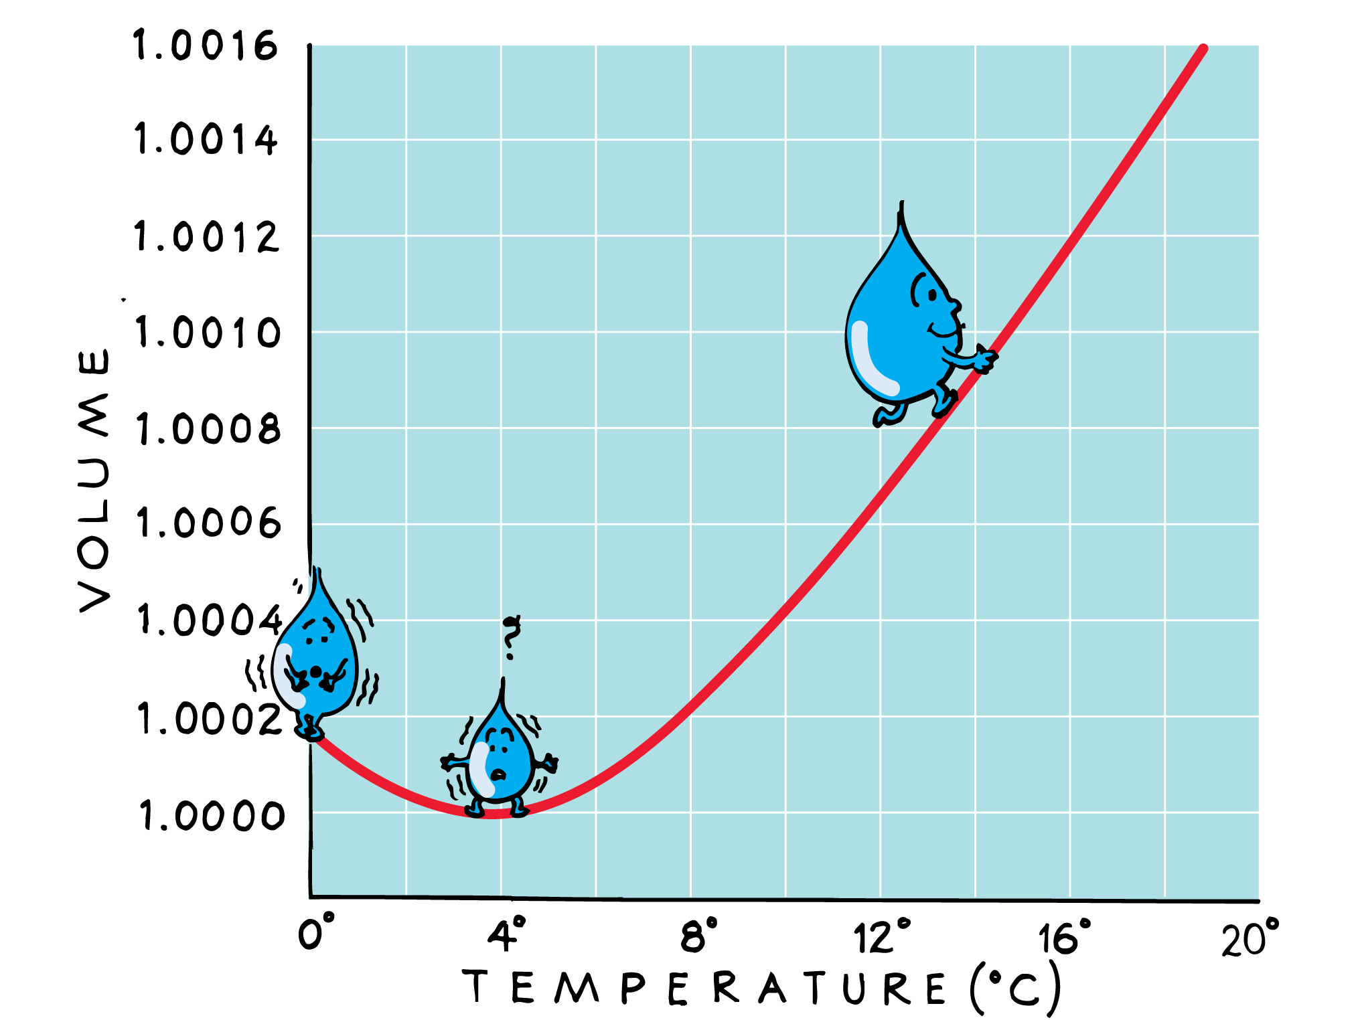
Expansion of Water
The graph shows the change in volume of water with increasing temperature.

Slide 84
Expansion of Water
A given amount of water has its smallest volume—and thus its greatest density—at 4°C.
The same amount of water has its largest volume—and smallest density—in its solid form, ice. (The volume of ice at 0°C is not shown in the graph.)
After water has turned to ice, further cooling causes it to contract.

Slide 85
Expansion of Water
This behavior of water has to do with the crystal structure of ice.
  The crystals of most solids are structured so that the solid state occupies a smaller volume than the liquid state.
  Ice, however, has open-structured crystals due to the shape of the water molecules and the strength of the forces binding molecules together at certain angles.
  Water molecules in this open structure occupy a greater volume than they do in the liquid state.

Slide 86
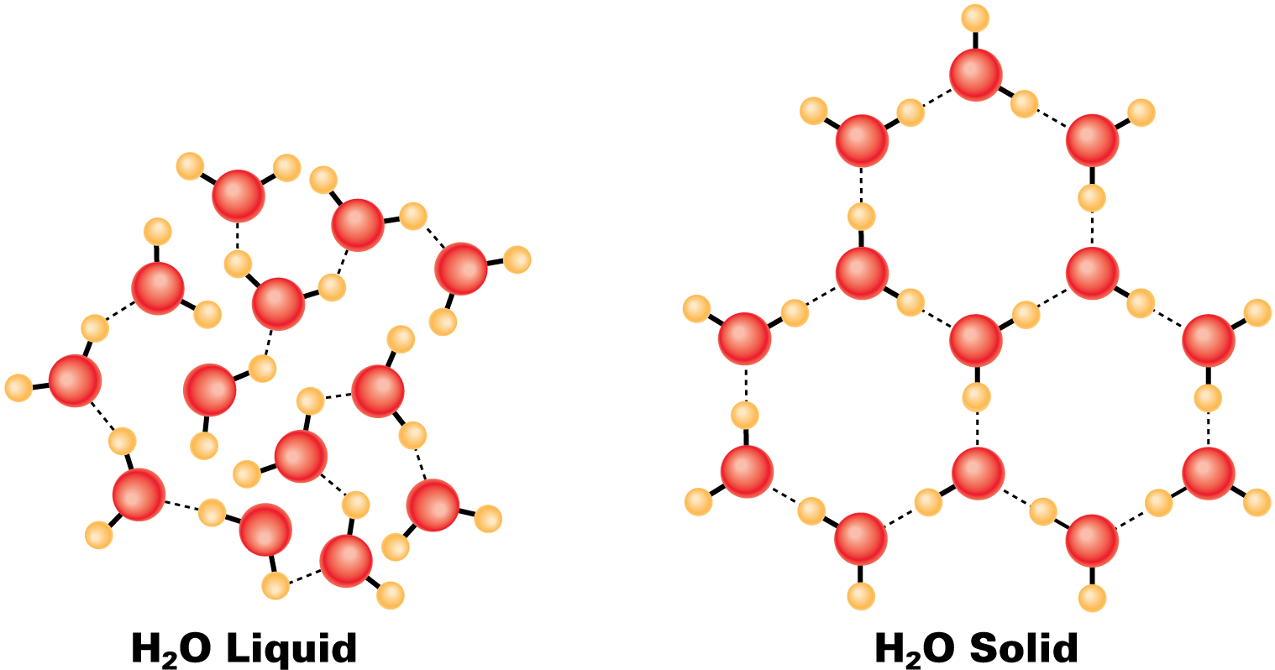
Expansion of Water
Water molecules in their crystal form have an open-structured, six-sided arrangement. As a result, water expands upon freezing, and ice is less dense than water.

Slide 87
Expansion of Water
Melting Ice
When ice melts, some crystals remain in the ice-water mixture, making a microscopic slush that slightly “bloats” the water.
  Ice water is therefore less dense than slightly warmer water.
  With an increase in temperature, more of the remaining ice crystals collapse.
  The melting of these crystals further decreases the volume of the water.

Slide 88
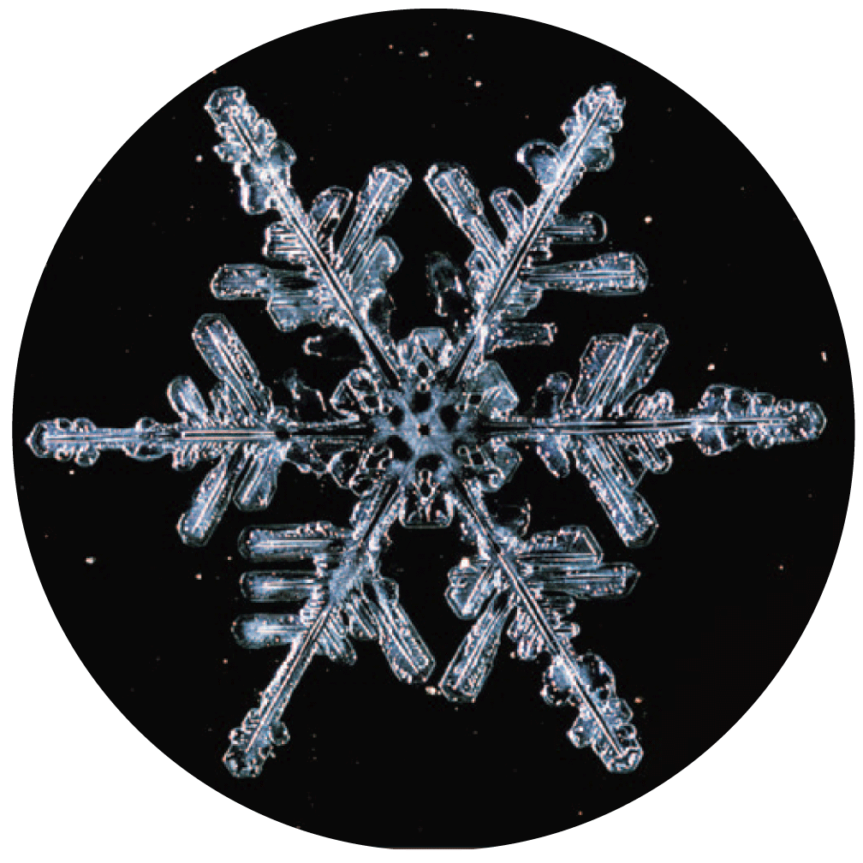
Expansion of Water
The six-sided structure of a snowflake is a result of the six-sided ice crystals that make it up.

Slide 89
Expansion of Water
While crystals are collapsing as the temperature increases between 0°C and 10°C, increased molecular motion results in expansion.
Whether ice crystals are in the water or not, increased vibrational motion of the molecules increases the volume of the water.

Slide 90
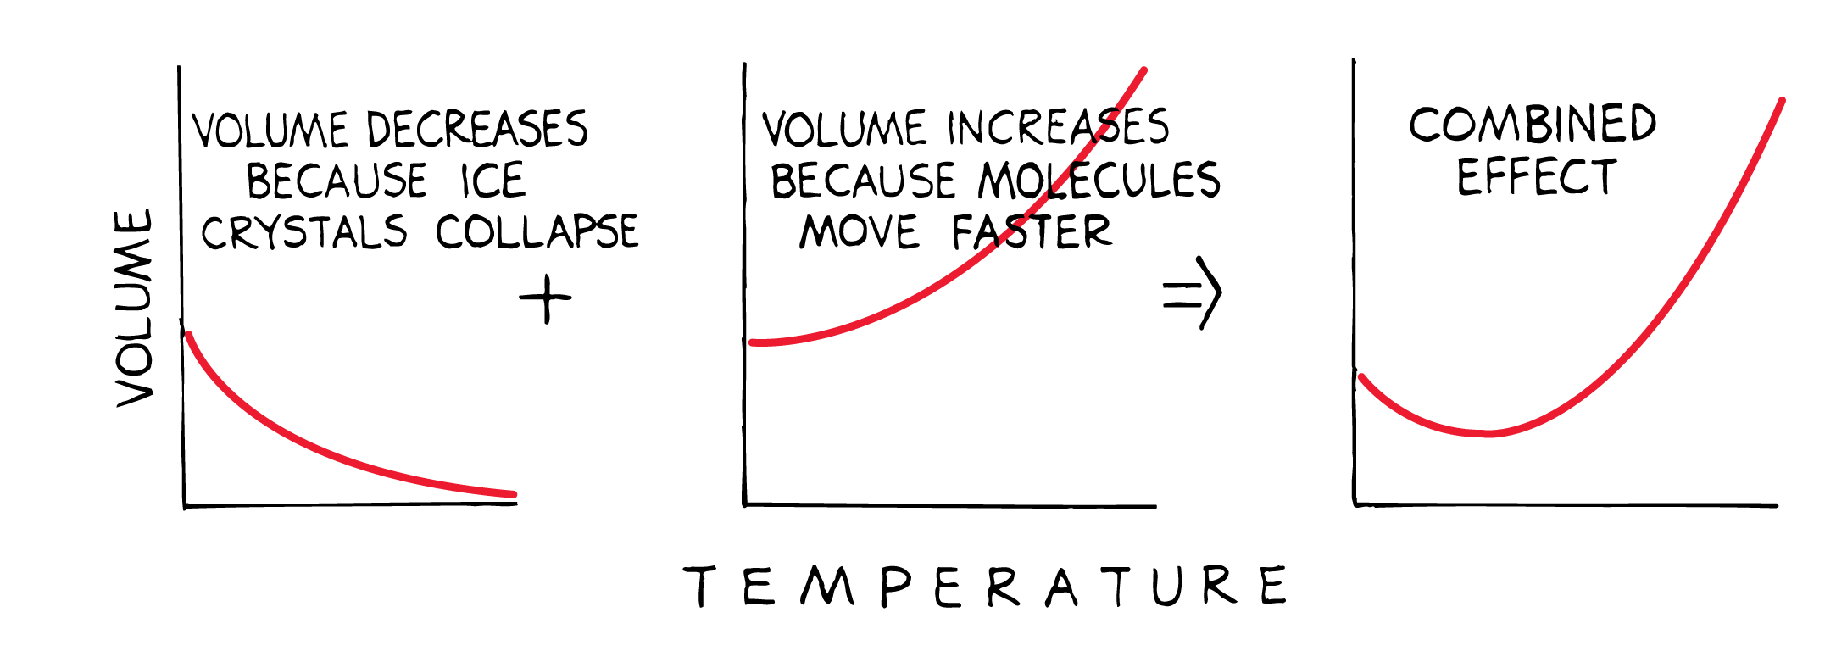
Expansion of Water
The collapsing of ice crystals (left) plus increased molecular motion with increasing temperature (center) combine to make water most dense at 4°C (right).

Slide 91
Expansion of Water
This behavior of water is of great importance in nature.
Suppose that the greatest density of water were at its freezing point, as is true of most liquids.
  Then the coldest water would settle to the bottom, and ponds would freeze from the bottom up.
  Pond organisms would then be destroyed in winter months.

Slide 92
Expansion of Water
Fortunately, this does not happen.
  The densest water, which settles at the bottom of a pond, is 4 degrees above the freezing temperature.
  Water at the freezing point, 0°C, is less dense and floats.
  Ice forms at the surface while the pond remains liquid below the ice.

Slide 93
Expansion of Water
Freezing Water
Most of the cooling in a pond takes place at its surface, when the surface air is colder than the water.
As the surface water is cooled, it becomes denser and sinks to the bottom.
Water will “float” at the surface for further cooling only if it is as dense as or less dense than the water below.

Slide 94
Expansion of Water
Consider a pond that is initially at, say, 10°C.
  It cannot be cooled to 0°C without first being cooled to 4°C.
  Water at 4°C cannot remain at the surface for further cooling unless all the water below has at least an equal density.
  If the water below the surface is any temperature other than 4°C, surface water at 4°C will be denser and sink.
  Ice cannot form until all the water in a pond is cooled to 4°C.

Slide 95
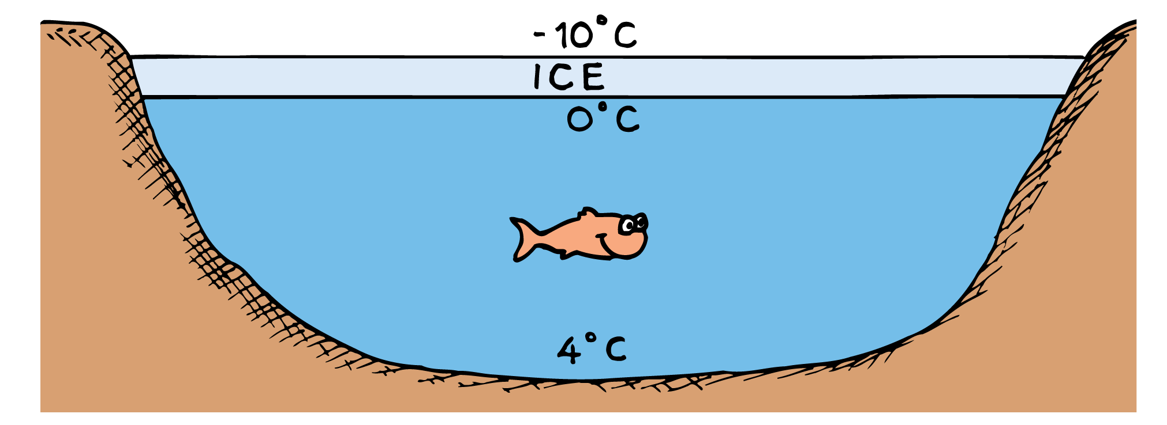
Expansion of Water
As water is cooled at the surface, it sinks until the entire lake is 4°C. Only then can the surface water cool to 0°C without sinking.

Slide 96
Expansion of Water
Thus, the water at the surface is first to freeze.
Continued cooling of the pond results in the freezing of the water next to the ice, so a pond freezes from the surface downward.
In a cold winter the ice will be thicker than in a milder winter.

Slide 97
Expansion of Water
Very deep bodies of water are not ice-covered even in the coldest of winters.
All the water in a lake must be cooled to 4°C before lower temperatures can be reached, and the winter is not long enough.
Because of water’s high specific heat and poor ability to conduct heat, the bottom of deep lakes in cold regions is a constant 4°C.

Slide 98
Expansion of Water
Why does ice float on water?

